Slide 1


City of Arcadia
Draft Maps Review Hearing

Slide 2
2021/2022 Arcadia Redistricting
The 2021/2022 redistricting process
  Project timelines
  Key deadlines
  Review of draft maps
  Project website – ArcadiaCA.gov/redistricting

Slide 3
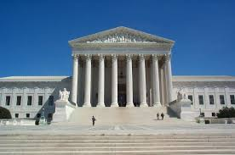
Redistricting Rules and Goals
1. Federal Laws
2. California Criteria for
Cities
3. Other Traditional Redistricting Principles
Equal Population
Federal Voting Rights Act
No Racial Gerrymandering
Geographically contiguous
Undivided neighborhoods and “communities of interest”
(Socio-economic geographic areas that should be kept together)
Easily identifiable boundaries
Compact
(Do not bypass one group of people to get to a more distant group of people)
Prohibited:
“Shall not favor or discriminate against a political party.”
Minimize voters shifted to different election years
Respect voters’ choices / continuity in office
Future population growth
Preserving the core of existing districts

Slide 4
Arcadia Demographic Overview
City of Arcadia - 2020 Census Data Total Population Statistics
District | CA Adjusted Pop. | Deviation | % Deviation | % Hispanic Origin | % NH White | % NH Black | % NH Asian
1 | 11,330 | -26 | -0.23% | 13.56% | 18.60% | 1.68% | 64.95%
2 | 10,265 | -1091 | -9.61% | 14.71% | 25.20% | 1.96% | 56.43%
3 | 12,148 | 792 | 6.97% | 17.05% | 15.06% | 2.86% | 63.26%
4 | 11,890 | 534 | 4.70% | 8.27% | 14.10% | 1.49% | 74.52%
5 | 11,148 | -208 | -1.83% | 11.98% | 16.04% | 1.15% | 69.09%
 |  | Total Deviation | 16.58%
City of Arcadia CVAP Data
District | Latino CVAP | White CVAP | Black CVAP | Asian CVAP
1 | 8.24% | 29.17% | 2.54% | 59.29%
2 | 13.49% | 38.26% | 2.38% | 45.37%
3 | 16.69% | 26.09% | 5.04% | 51.95%
4 | 6.60% | 22.06% | 1.66% | 68.28%
5 | 9.11% | 25.15% | 0.48% | 64.36%
Tables show official 2020 demographic data
Each of the 5 districts must contain about 11,356 people.

Slide 5
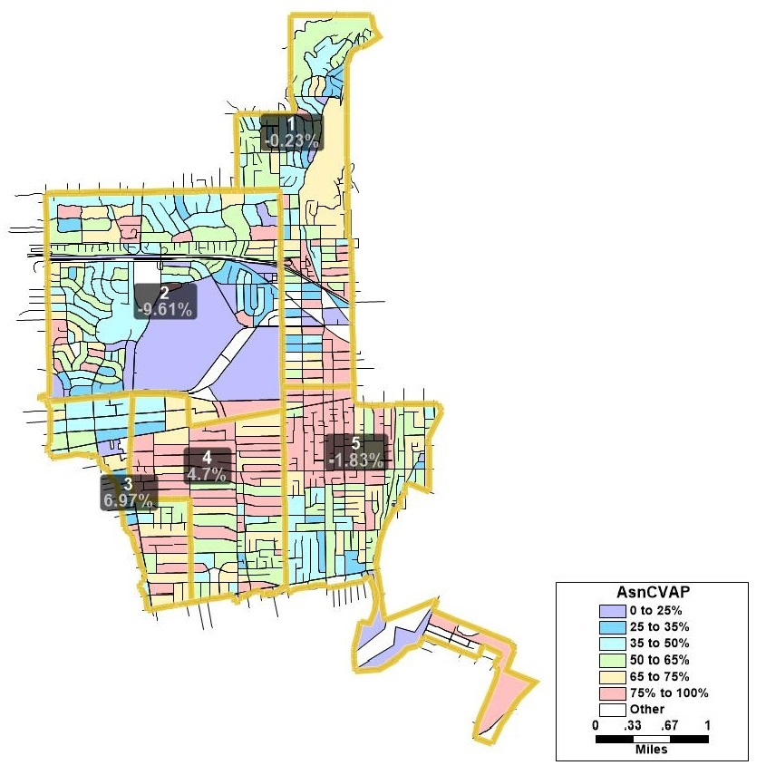
Asian-American CVAP

Slide 6
Timeline & Next Steps
Date(s) | Description | Comments
August 17, 2021 | 1st Public Hearing
October 2021 | Mapping software released to the public. US Census data released mid-August. California released the prisoner-adjusted redistricting data on September 27
November 10, 2021 | 2nd hearing – Community Workshop
January 15, 2022 | Deadline to receive draft maps
February 1, 2022 | 3rd hearing
March 1, 2022 | Council Meeting to Discuss Revised Maps
March 15, 2022 | Council Meeting to Discuss Revised Maps | Council to choose District map. First reading of ordinance. Must be completed no later than April 17, 2021
TBD | Second reading of Ordinance. Must take place at a regularly-scheluded City Council meeting.
April 17, 2022 (E-205) | City deadline to adopt and submit map to Registrar

Slide 7
For the Remainder of This Evening’s Hearing
Review of draft maps
Direction from Council regarding which map they would like to move forward with
Focus Maps:
  Map 103
  Map 114 A Revised
  Map 115 B Revised
  Map 116 C
  Map 118
Note: NDC has concerns with Map 114 A Revised regarding the Federal Voting Rights Act and would not recommend its passage.

